Slide 1


Network protocols & security
24EC2210
Topic:
MAC PROTOCOLS: CSMA
Session – 11

Slide 2



AIM OF THE SESSION
To familiarize students with the basic idea of CSMA protocols
INSTRUCTIONAL OBJECTIVES
This Session is designed to:
Demonstrate the need for CSMA protocols
Describe the working of CSMA protocols
LEARNING OUTCOMES
At the end of this session, you should be able to:
Understand the working of CSMA protocol.
Understand the working of CSMA/CD and CSMA/CA protocols.
Differentiate CSMA, CSMA/CD and CSMA/CA protocols.

Slide 3
SESSION INTRODUCTION
CSMA Protocols
CSMA
CSMA/CD
CSMA/CA
CSMA Protocols
CSMA
CSMA/CD
CSMA/CA

Slide 4
CSMA Protocol
Carrier Sense Multiple Access protocol.
To minimize the chance of collision and, therefore, increase the performance, the CSMA method was developed.
The chance of collision can be reduced if a station senses the medium before trying to use it.
CSMA requires that each station first listen to the medium (or check the state of the medium) before sending. “sense before transmit” or “listen before talk.”
CSMA can reduce the possibility of collision, but it cannot eliminate it.
The possibility of collision still exists because of propagation delay - when a station sends a frame, it still takes time (although very short) for the first bit to reach every station and for every station to sense it.
In other words, a station may sense the medium and find it idle, only because the first bit sent by another station has not yet been received.

Slide 5
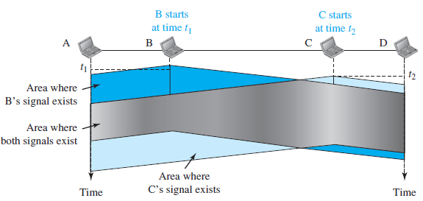
Figure: Space/time model of the collision in CSMA
At time t1, station B senses the medium and finds it idle, so it sends a frame. At time t2 (t2 > t1), station C senses the medium and finds it idle because, at this time, the first bits from station B have not reached station C. Station C also sends a frame. The two signals collide and both frames are destroyed.

Slide 6
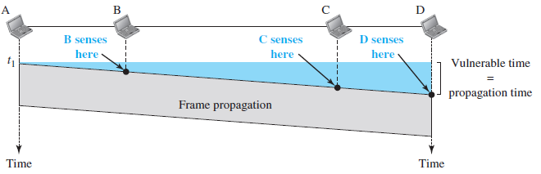
Vulnerable time in CSMA
The vulnerable time for CSMA is the propagation time Tp. This is the time needed for a signal to propagate from one end of the medium to the other.
When a station sends a frame and any other station tries to send a frame during this time, a collision will result.
But if the first bit of the frame reaches the end of the medium, every station will already have heard the bit and will refrain from sending.
The leftmost station, A, sends a frame at time t1, which reaches the rightmost station, D, at time t1 + Tp.

Slide 7
CSMA Persistence Methods

Slide 8
CSMA Persistence Methods
What should a station do if the channel is busy?
What should a station do if the channel is idle?
Three methods have been devised to answer these questions:
1-persistent method
Non-persistent method
p-persistent method.

Slide 9
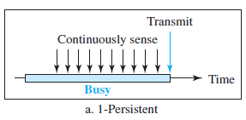
CSMA Persistence Methods…
1-persistent Method:
The 1-persistent method is simple and straightforward.
In this method, after the station finds the line idle, it sends its frame immediately (with probability 1).
This method has the highest chance of collision because two or more stations may find the line idle and send their frames immediately.

Slide 10
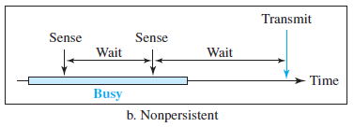
CSMA Persistence Methods…
Non-persistent Method:
In the nonpersistent method, a station that has a frame to send senses the line. If the line is idle, it sends immediately.
If the line is not idle, it waits a random amount of time and then senses the line again.
The nonpersistent approach reduces the chance of collision because it is unlikely that two or more stations will wait the same amount of time and retry to send simultaneously.
However, this method reduces the efficiency of the network because the medium remains idle when there may be stations with frames to send.

Slide 11
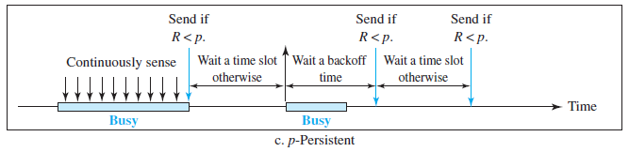
CSMA Persistence Methods…
p-persistent Method:
The p-persistent method is used if the channel has time slots with a slot duration equal to or greater than the maximum propagation time.
The p-persistent approach combines the advantages of the other two strategies.
It reduces the chance of collision and improves efficiency.
In this method, after the station finds the line idle it follows these steps:
1. With probability p, the station sends its frame.
2. With probability q = 1 - p, the station waits for the beginning of the next time slot and checks the line again.
a. If the line is idle, it goes to step 1.
b. If the line is busy, it acts as though a collision has occurred and uses the backoff procedure.

Slide 12
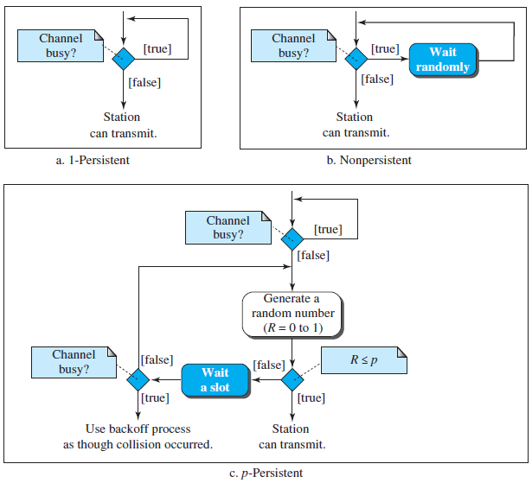
Flow diagrams of CSMA Persistence Methods

Slide 13
CSMA/CD

Slide 14
CSMA/CD Protocol
Carrier Sense Multiple Access with Collision Detection.
In this method, a station monitors the medium after it sends a frame to see if the transmission was successful. If so, the station is finished.
If, however, there is a collision, the frame is sent again.

Slide 15
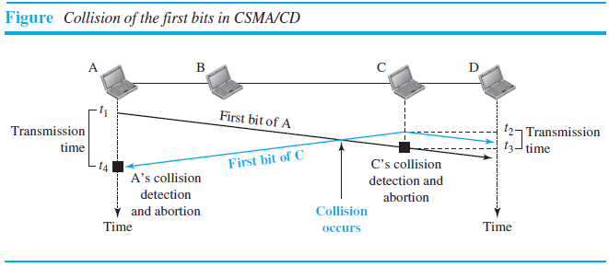
Collision of the first bits in CSMA/CD…
At time t1, station A has executed its persistence procedure and starts sending the bits of its frame.
At time t2, station C has not yet sensed the first bit sent by A. Station C executes its persistence procedure and starts sending the bits in its frame, which propagate both to the left and to the right.
The collision occurs sometime after time t2. Station C detects a collision at time t3 when it receives the first bit of A’s frame. Station C immediately aborts transmission.
Station A detects collision at time t4 when it receives the first bit of C’s frame; it also immediately aborts transmission.
Looking at the figure, we see that A transmits for the duration t4 - t1; C transmits for the duration t3 - t2.

Slide 16
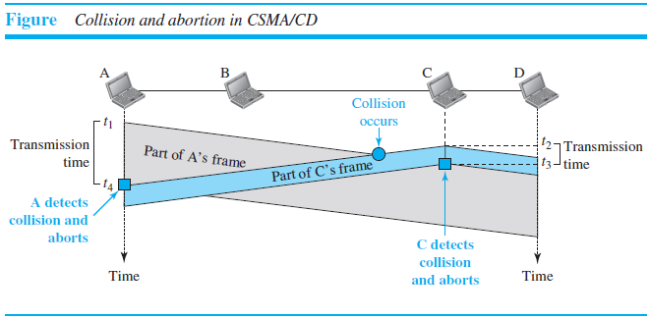

Slide 17
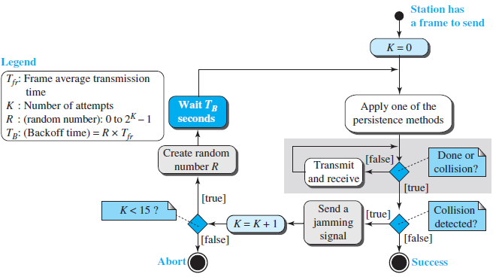
Flow diagram for the CSMA/CD

Slide 18
Throughput of CSMA/CD
The throughput of CSMA/CD is greater than that of pure or slotted ALOHA.
The maximum throughput occurs at a different value of G.
For the 1-persistent method, the maximum throughput is around 50 percent when G = 1.
For the nonpersistent method, the maximum throughput can go up to 90 percent when G is between 3 and 8.
For the p-persistent method, the maximum throughput depends on the G value and the p value.

Slide 19
CSMA/CA

Slide 20
CSMA/CA Protocol
Carrier Sense Multiple Access with Collision Avoidance
Invented for wireless networks.
Collisions are avoided through the use of CSMA/CA’s three strategies:
Interframe space,
Contention window
Acknowledgments
RTS and CTS control frames are included.

Slide 21
Interframe Space (IFS)
First, collisions are avoided by deferring transmission even if the channel is found idle.
When an idle channel is found, the station does not send immediately. It waits for a period of time called the interframe space or IFS.
Even though the channel may appear idle when it is sensed, a distant station may have already started transmitting. The distant station’s signal has not yet reached this station.
After waiting an IFS time, if the channel is still idle, the station can send, but it still needs to wait a time equal to the contention window.

Slide 22
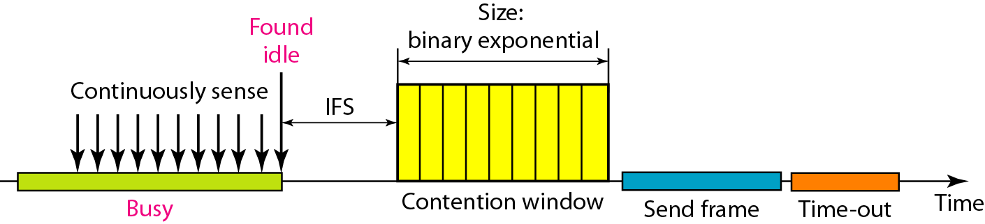
Contention Window
The contention window is an amount of time divided into slots.
A station that is ready to send chooses a random number of slots as its wait time.
The number of slots in the window changes according to the binary exponential backoff strategy. This means that it is set to one slot the first time and then doubles each time the station cannot detect an idle channel after the IFS time.
One interesting point about the contention window is that the station needs to sense the channel after each time slot. However, if the station finds the channel busy, it does not restart the process; it just stops the timer and restarts it when the channel is sensed as idle.

Slide 23
Acknowledgment…
With all these precautions, there still may be a collision resulting in destroyed data.
In addition, the data may be corrupted during the transmission.
The positive acknowledgment and the time-out timer can help guarantee that the receiver has received the frame.

Slide 24
Acknowledgment…
Exchange of data and control frames in time:
1. Before sending a frame, the source station senses the medium.
a. The channel uses a persistence strategy with backoff until the channel is idle.
b. After the station is found to be idle, the station waits for a period of time called the DCF interframe space (DIFS); then the station sends a control frame called the request to send (RTS).
2. After receiving the RTS and waiting a period of time called the short interframe space (SIFS), the destination station sends a control frame, called the clear to send (CTS), to the source station. This control frame indicates that the destination station is ready to receive data.
3. The source station sends data after waiting an amount of time equal to SIFS.
4. The destination station, after waiting an amount of time equal to SIFS, sends an acknowledgment to show that the frame has been received. arrived.

Slide 25
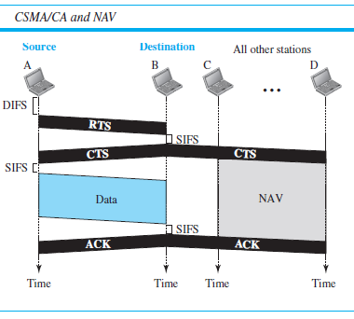
Acknowledgment…
Network Allocation Vector:
How do other stations defer sending their data if one station acquires access?
How is the collision avoidance aspect of this protocol accomplished?
The key is a feature called NAV.
When a station sends an RTS frame, it includes the duration of time that it needs to occupy the channel. The stations that are affected by this transmission create a timer called a network allocation vector (NAV) that shows how much time must pass before these stations are allowed to check the channel for idleness.
Each time a station accesses the system and sends an RTS frame, other stations start their NAV.
Each station, before sensing the physical medium to see if it is idle, first checks its NAV to see if it has expired.

Slide 26
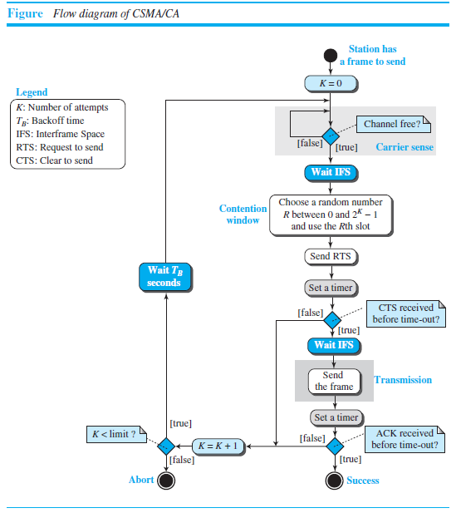

Slide 27

SUMMARY
CSMA Protocols
CSMA
CSMA/CD
CSMA/CA

Slide 28
TERMINAL QUESTIONS
Describe the working of CSMA protocol.
Explain about the three CSMA persistent methods.
Demonstrate the working principle of CSMA/CD and CSMA/CA protocols.
Compare CSMA, CSMA/CD and CSMA/CA protocols.

Slide 29
REFERENCES FOR FURTHER LEARNING OF THE SESSION
Reference Books:
Behrouz A. Forouzan , “Data Communication and Networking”, TMH, 5th Edition, 2012.
A.S. Tanenbaum, David J. Wetheral “Computer Networks” Pearson, 5th Edition.

Slide 30
THANK YOU
Team – Network Protocols & Security

